Slide 1
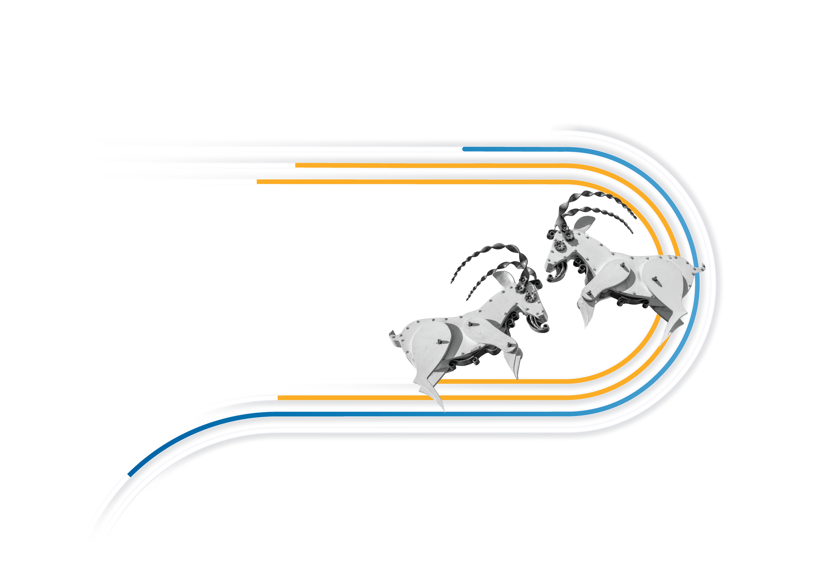
Autonomiczne oferowanie i kwotowanie transportów.
Co może pójść nie tak?

Slide 2
Jeśli uważasz, że technologia rozwiąże twoje problemy, to nie rozumiesz ani technologii ani swoich problemów
Laurie Anderson

Slide 3
‘Spot Happens’
Czyli jak zaczynamy wykorzystywać SI w operacjach spedycyjnych

Slide 4
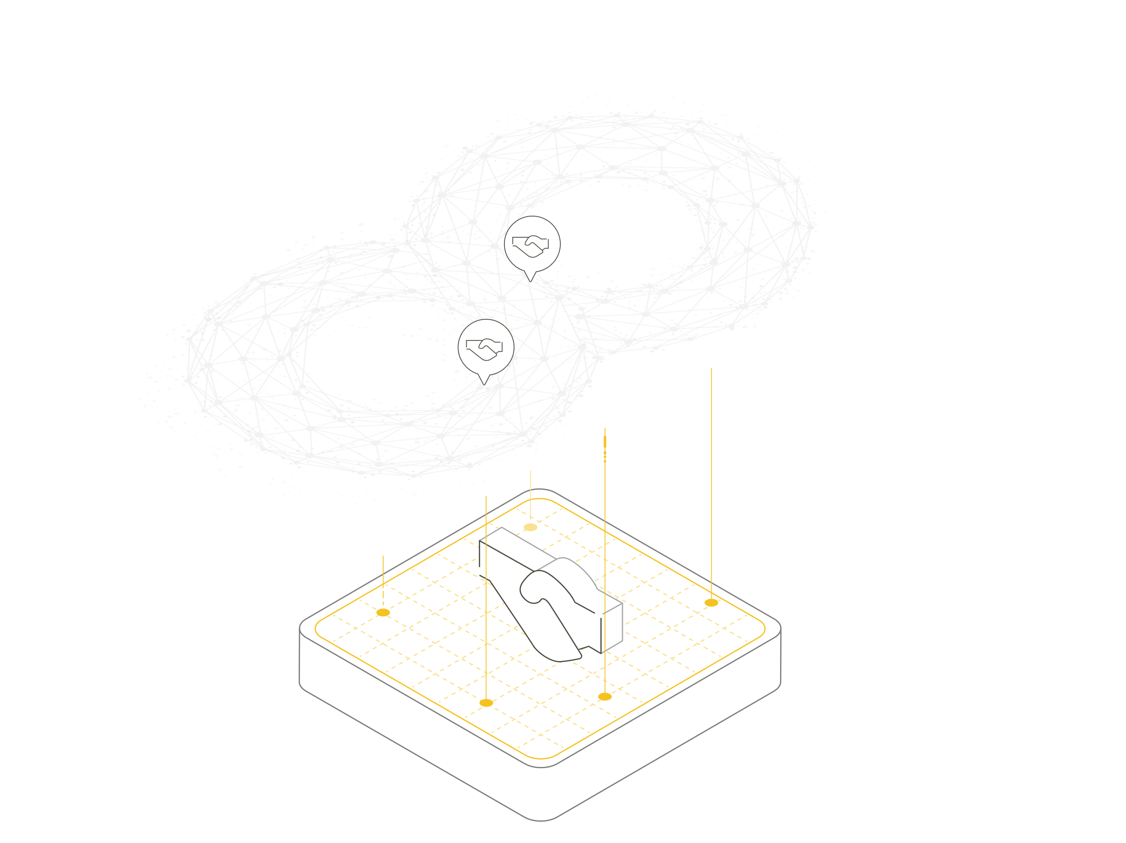
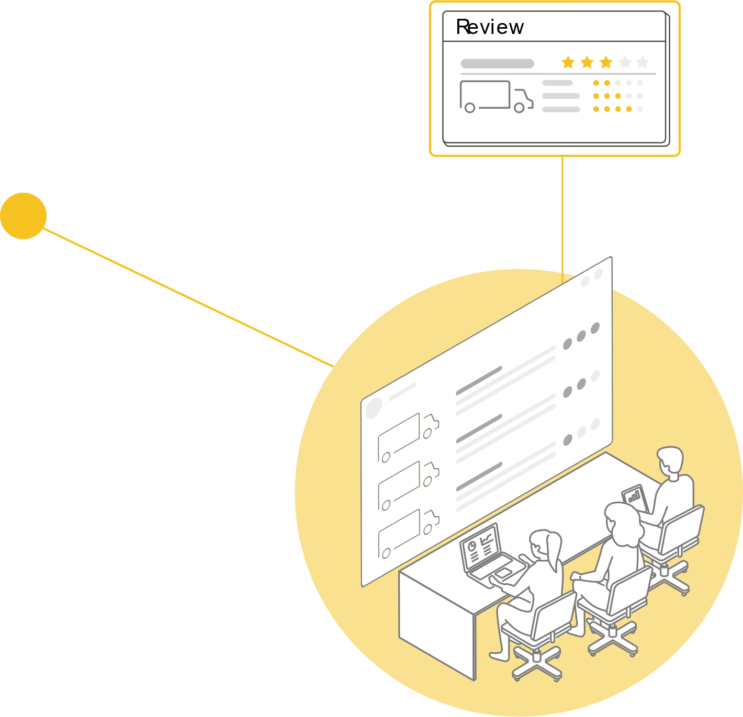
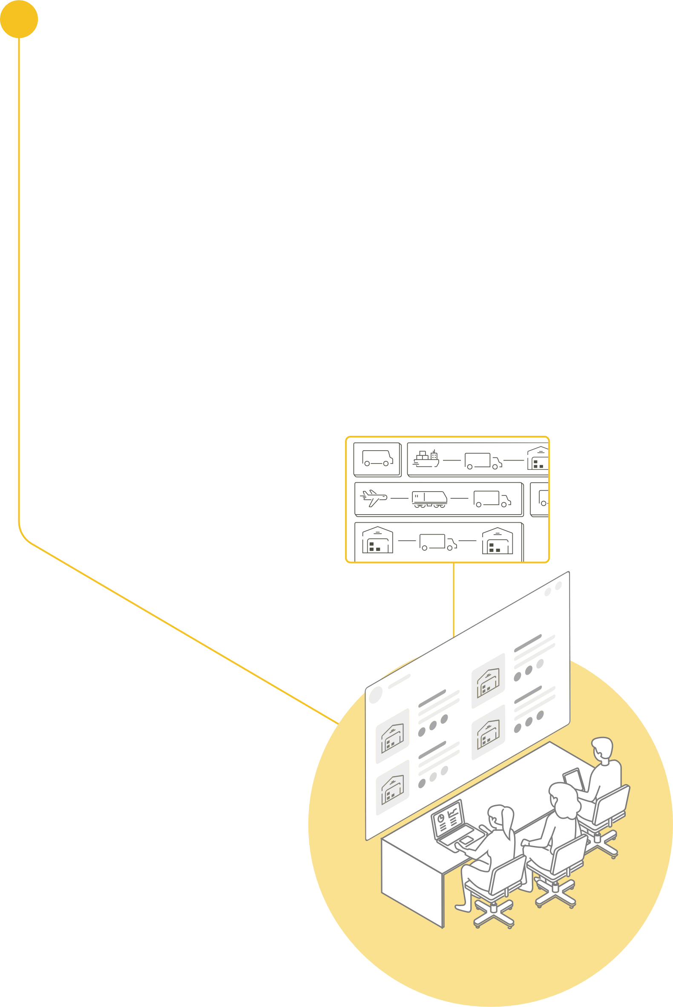
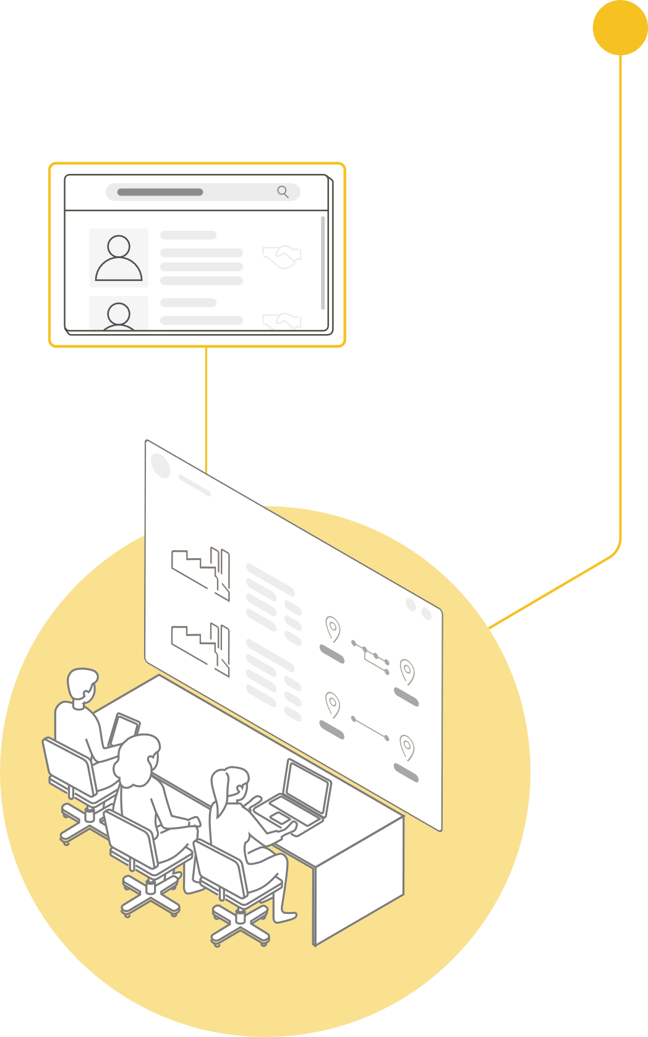
‘W idealnym świecie’
Notes:
The main benefit of Autonomous Procurement versus Best Carrier is that the freight auction is reversed from collecting bids to automation matching between loads and empty trucks.
From one side, the time you invest in the procurement process of the spot loads is reduced, but the cost or price to pay to the carrier also decreases as the platform make personalized and dynamic offers to each of those until a load is successfully matched.

Slide 5



Rzeczywistość skalowania operacji spedycyjnej
If posisble pls separate 1 „employee” of each type so I can mix those with green / yellow / red dots
Notes:
The freight forwarding industry has undergone a fundamental shift in recent years. With the rise of e-commerce and globalization, shippers are demanding faster and more reliable shipping options. In response, freight brokers and logistics service providers are under pressure to deliver instant and accurate pricing to their customers.
Due to the fact that freight brokers and logistics service providers are constantly are under pressure to deliver instant and accurate pricing they tend to quote less, simply because they don’t have enough resources or time to create an accurate quote that would benefit both the shipper and the carrier. In order to thrive in the current market conditions, you have to capture every opportunity you have, quote more and win more. With the current solutions in place it is still hard to quote more, as the whole process is very labor intensive.
Freight forwarders typically use traditional methods such as manual negotiation, freight auction portals, load boards or broad brush freight index services (such as DAT) to provide quotes to their shipper customers. The challenges they experience throughout the spot quotation process includes: Checking historical data, or going to Freight Index Services (DAT, Freight Waves, Cass Index)
Checking customer specific rules
Finalizing a Quote – through emails, customer TMS portals or even calling them.
On average it takes around 5+ minutes per Quote

Slide 6


A może mała rewolucja ?

Slide 7


Odwrócenie ról
Typowe „kupowanie” transportu spot
PLAN
OFERTY
AKCEPTACJA
REALIZACJA
OPERACJA LICZONA W GODZINACH
Autonomiczne kupowanie na rynku spot
PLAN
AUTONOMICZNE ZAKUPY
REALIZACJA
Oprogramowanie decyduje, któremu z zatwierdzonych przewoźników złożyć ofertę, po jakiej cenie, w jakim czasie i jak reagować na kontroferty.
OPERACJA LICZONA W MINUTACH
Notes:
The main benefit of Autonomous Procurement versus Best Carrier is that the freight auction is reversed from collecting bids to automation matching between loads and empty trucks.
From one side, the time you invest in the procurement process of the spot loads is reduced, but the cost or price to pay to the carrier also decreases as the platform make personalized and dynamic offers to each of those until a load is successfully matched.

Slide 8
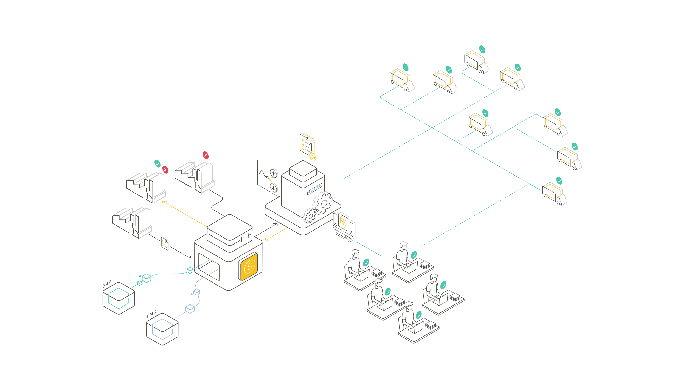

Slide 9
‘Co może pójść nie tak ? ’
a tak naprawdę - dlaczego SI jest ( jeszcze) szansą a nie zagrożeniem

Slide 10
Preliminary animated ( finally each phrase will be poping in and the out before next come) – I will use this for summary. Below each test I ‚ve added translation so if you find a way to underline / make it dynamic / a’la last step in show would be great whatever method you choose. Otherwise we can keep as it is
Emocje / Zmiana
Sytuacje nietypowe / wydarzenia „alogiczne”
Konkurujące standardy
Jakość danych
Potrzeba kontroli

Slide 12
Contact data or further business information

Slide 13
Graphic elements to improve your presentation.
Second Headline
Second Headline
Note: The contrast colors can also be used sparingly for recording.
The yellow color can also be
used in it‘s fund color.
Here is a download link for our image database: https//: xxxxx
Second Headline
Second Headline
Box Headline
Text Box
Box Headline
Text Box
Box Headline
Text Box
Box Headline
Text Box
Box Headline
Text Box
Box Headline
Text Box

Slide 14
Icon set to improve your presentation.

